Slide 2


Introduce your two friends. One friend should be similar to you; the other friend should be different.

Slide 3
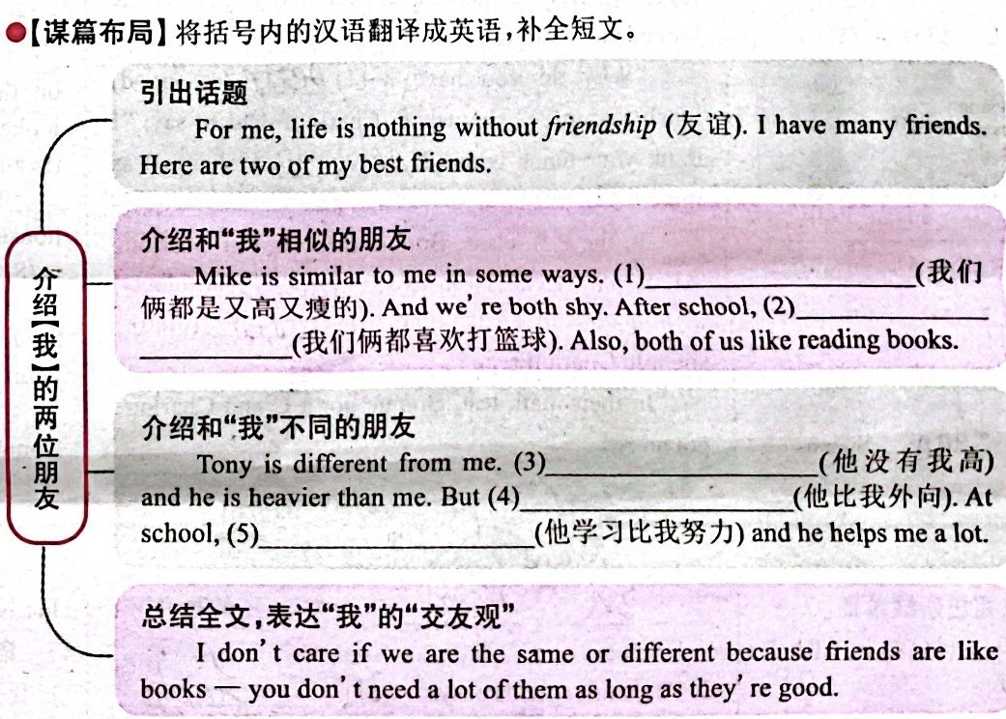
Both of us are tall and thin
We both like playing
basketball
He is not as tall as me
he is more outgoing than me
he studies harder than me

